Slide 1




Task: Implement UART communication to transmit real-time sensor data to a computer.
Initialize UART
Set baud rate (e.g., 9600 bps)
Read sensor value
Send formatted data via TX
Monitor output on PC

Slide 2
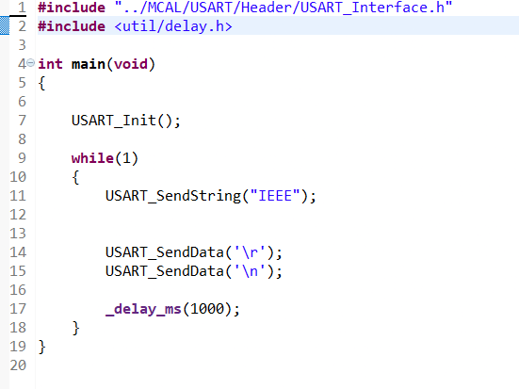
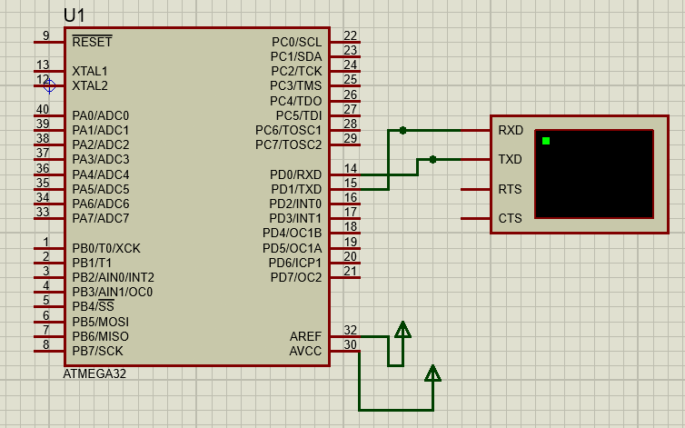
Task solution

Slide 3
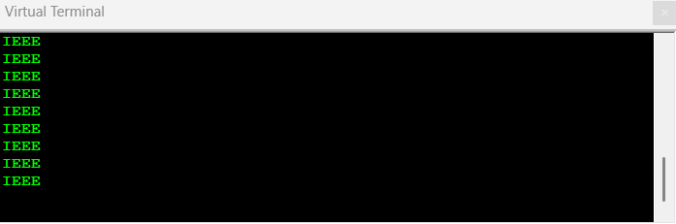
Task solution

Slide 4


Thank You!
Any questions?

